Slide 1
Discrete Mathematics BCSC 0010 Subgroup, some other question

Slide 2
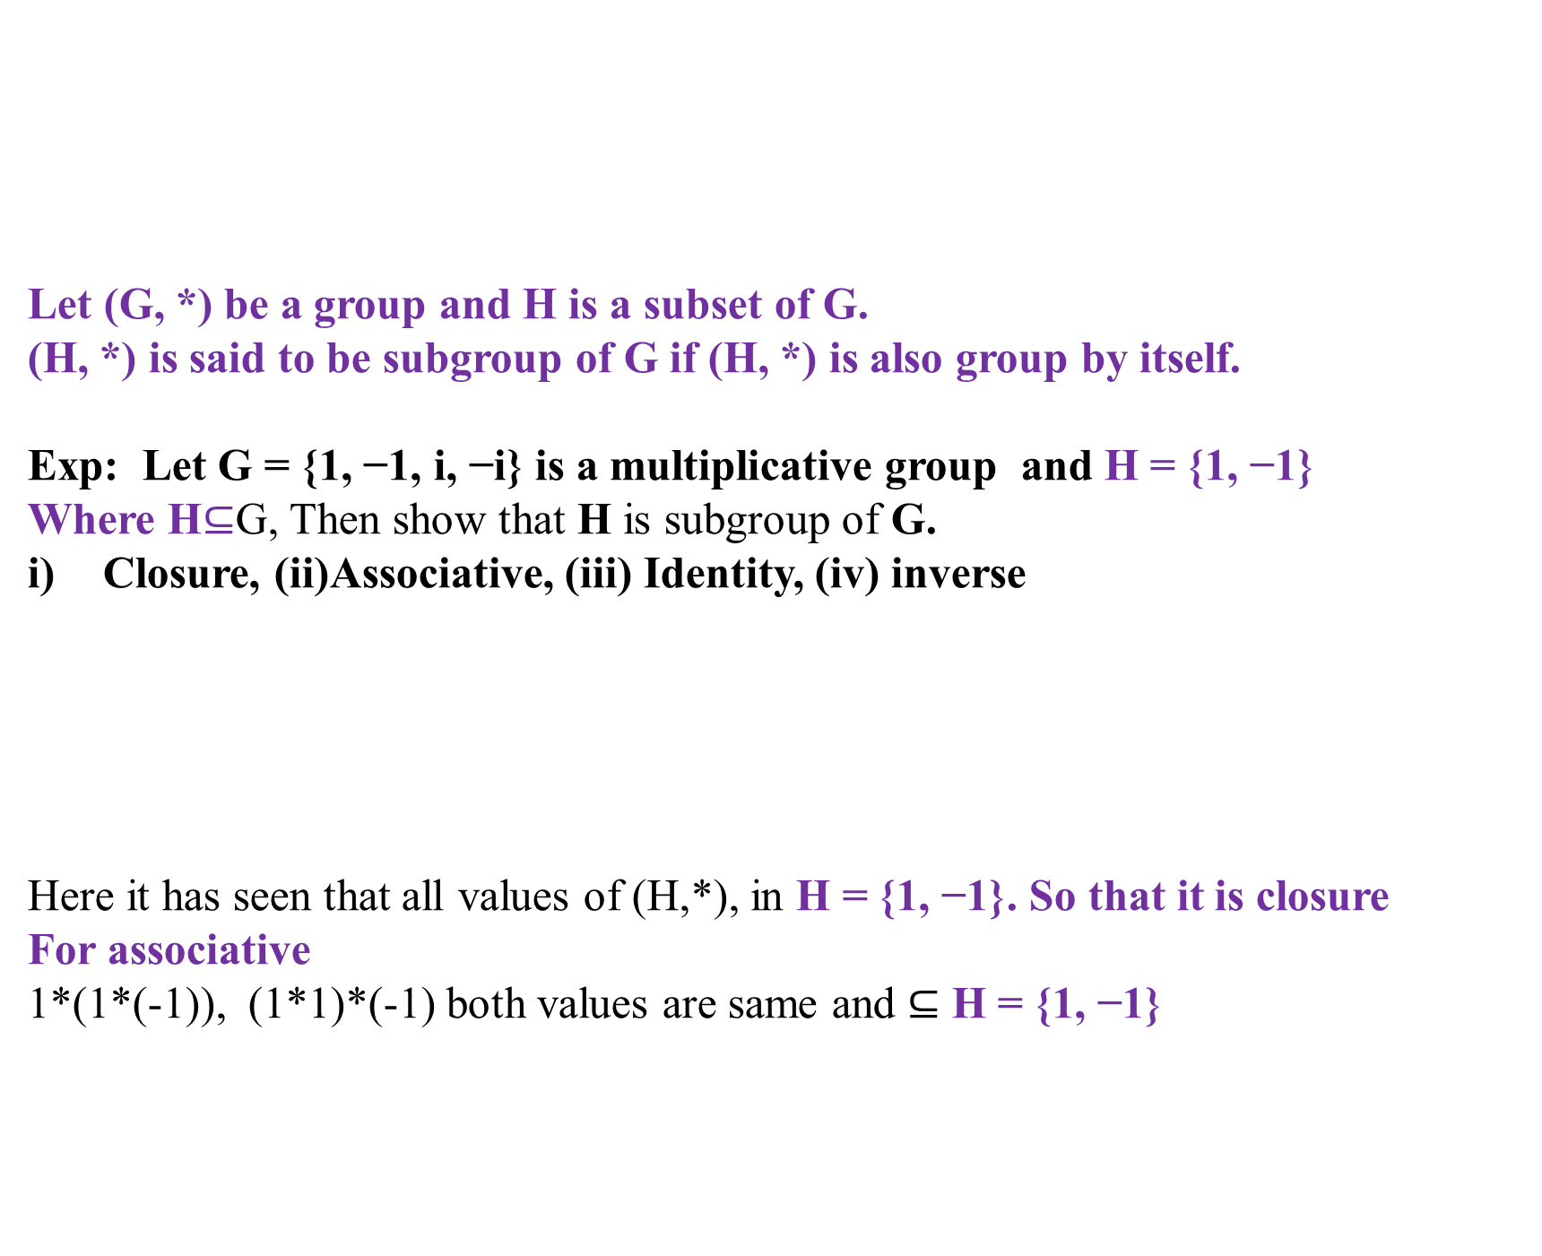
Subgroup
Let (G, *) be a group and H is a subset of G.
(H, *) is said to be subgroup of G if (H, *) is also group by itself.
Exp: Let G = {1, −1, i, −i} is a multiplicative group and H = {1, −1}
Where H$⊆$G, Then show that H is subgroup of G.
Closure, (ii)Associative, (iii) Identity, (iv) inverse
Here it has seen that all values of (H,*), in H = {1, −1}. So that it is closure
For associative
1*(1*(-1)), (1*1)*(-1) both values are same and $⊆$ H = {1, −1}
* | 1 | -1
1 | 1 | -1
-1 | -1 | 1

Slide 3
Subgroup
Let (G, *) be a group and H is a subset of G.
(H, *) is said to be subgroup of G if (H, *) is also group by itself.
(iii) Identity
From the table it has seen the identity element is “1”.
(IV) Inverse element
For 1, the inverse element is (1)
For -1, the inverse element is (-1)
* | 1 | -1
1 | 1 | -1
-1 | -1 | 1

Slide 4
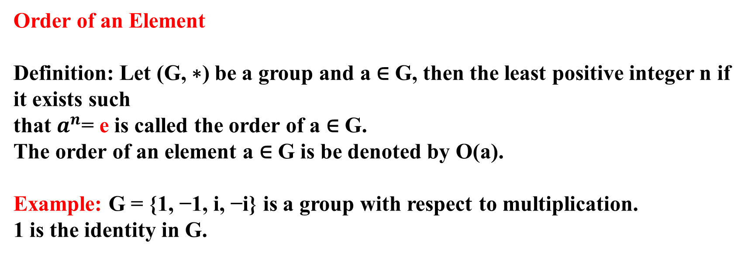
Order of an Element
Definition: Let (G, ∗) be a group and a ∈ G, then the least positive integer n if it exists such
that $a^{n}$= e is called the order of a ∈ G.
The order of an element a ∈ G is be denoted by O(a).
Example: G = {1, −1, i, −i} is a group with respect to multiplication.
1 is the identity in G.
* | 1 | -1 | i | -i
1 | 1 | -1 | i | -i
-1 | -1 | 1 | -i | i
i | i | -i | -1 | 1
-i | -i | i | 1 | -1

Slide 5
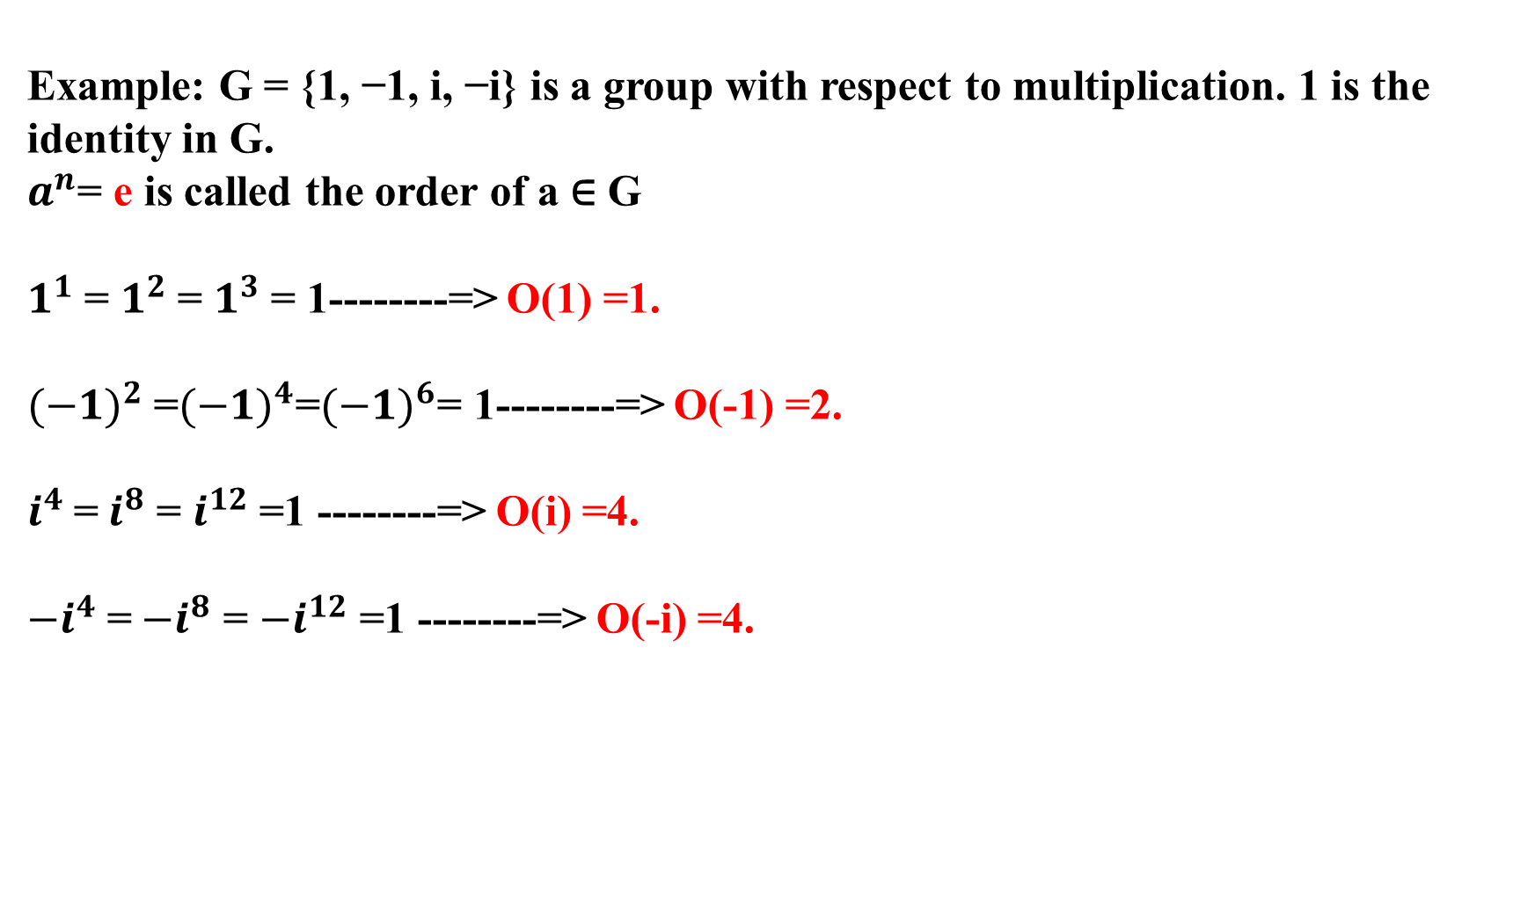
Example: G = {1, −1, i, −i} is a group with respect to multiplication. 1 is the identity in G.
$a^{n}$= e is called the order of a ∈ G
$1^{1}$= $1^{2}$= $1^{3}$= 1--------=> O(1) =1.
${(−1)}^{2}$=${(−1)}^{4}$=${(−1)}^{6}$= 1--------=> O(-1) =2.
$i^{4}$=${ i}^{8}$ = $i^{12}$ =1 --------=> O(i) =4.
${−i}^{4}$=${ −i}^{8}$ = ${−i}^{12}$ =1 --------=> O(-i) =4.

Slide 6
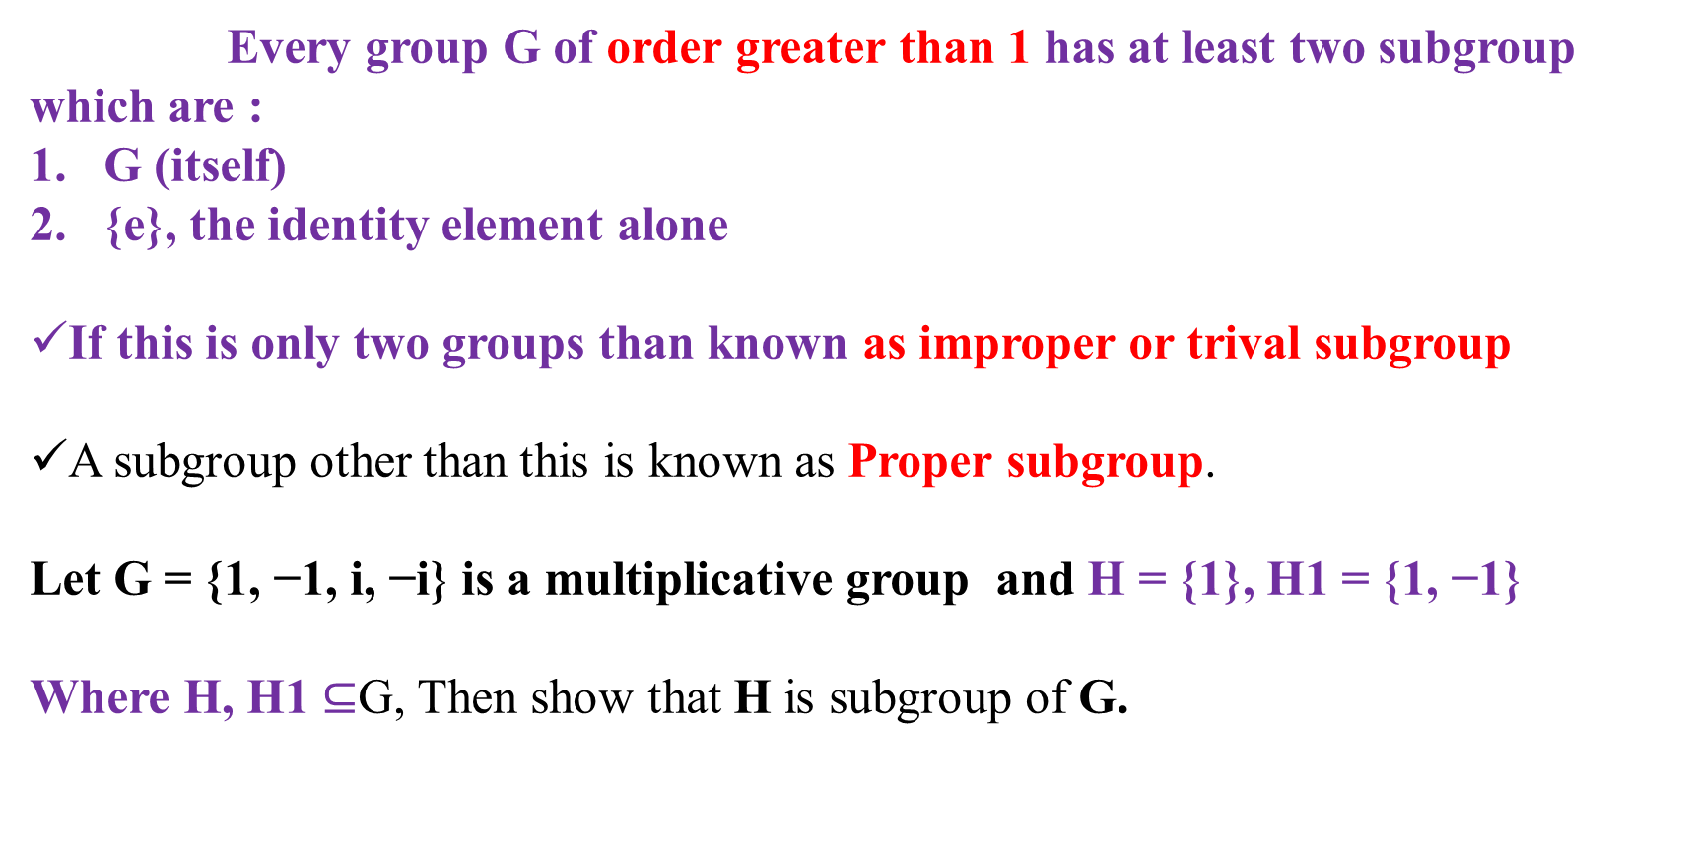
Types of subgroup
Every group G of order greater than 1 has at least two subgroup which are :
G (itself)
{e}, the identity element alone
If this is only two groups than known as improper or trival subgroup
A subgroup other than this is known as Proper subgroup.
Let G = {1, −1, i, −i} is a multiplicative group and H = {1}, H1 = {1, −1}
Where H, H1 $⊆$G, Then show that H is subgroup of G.
* | 1 | -1
1 | 1 | -1
-1 | -1 | 1

Slide 7
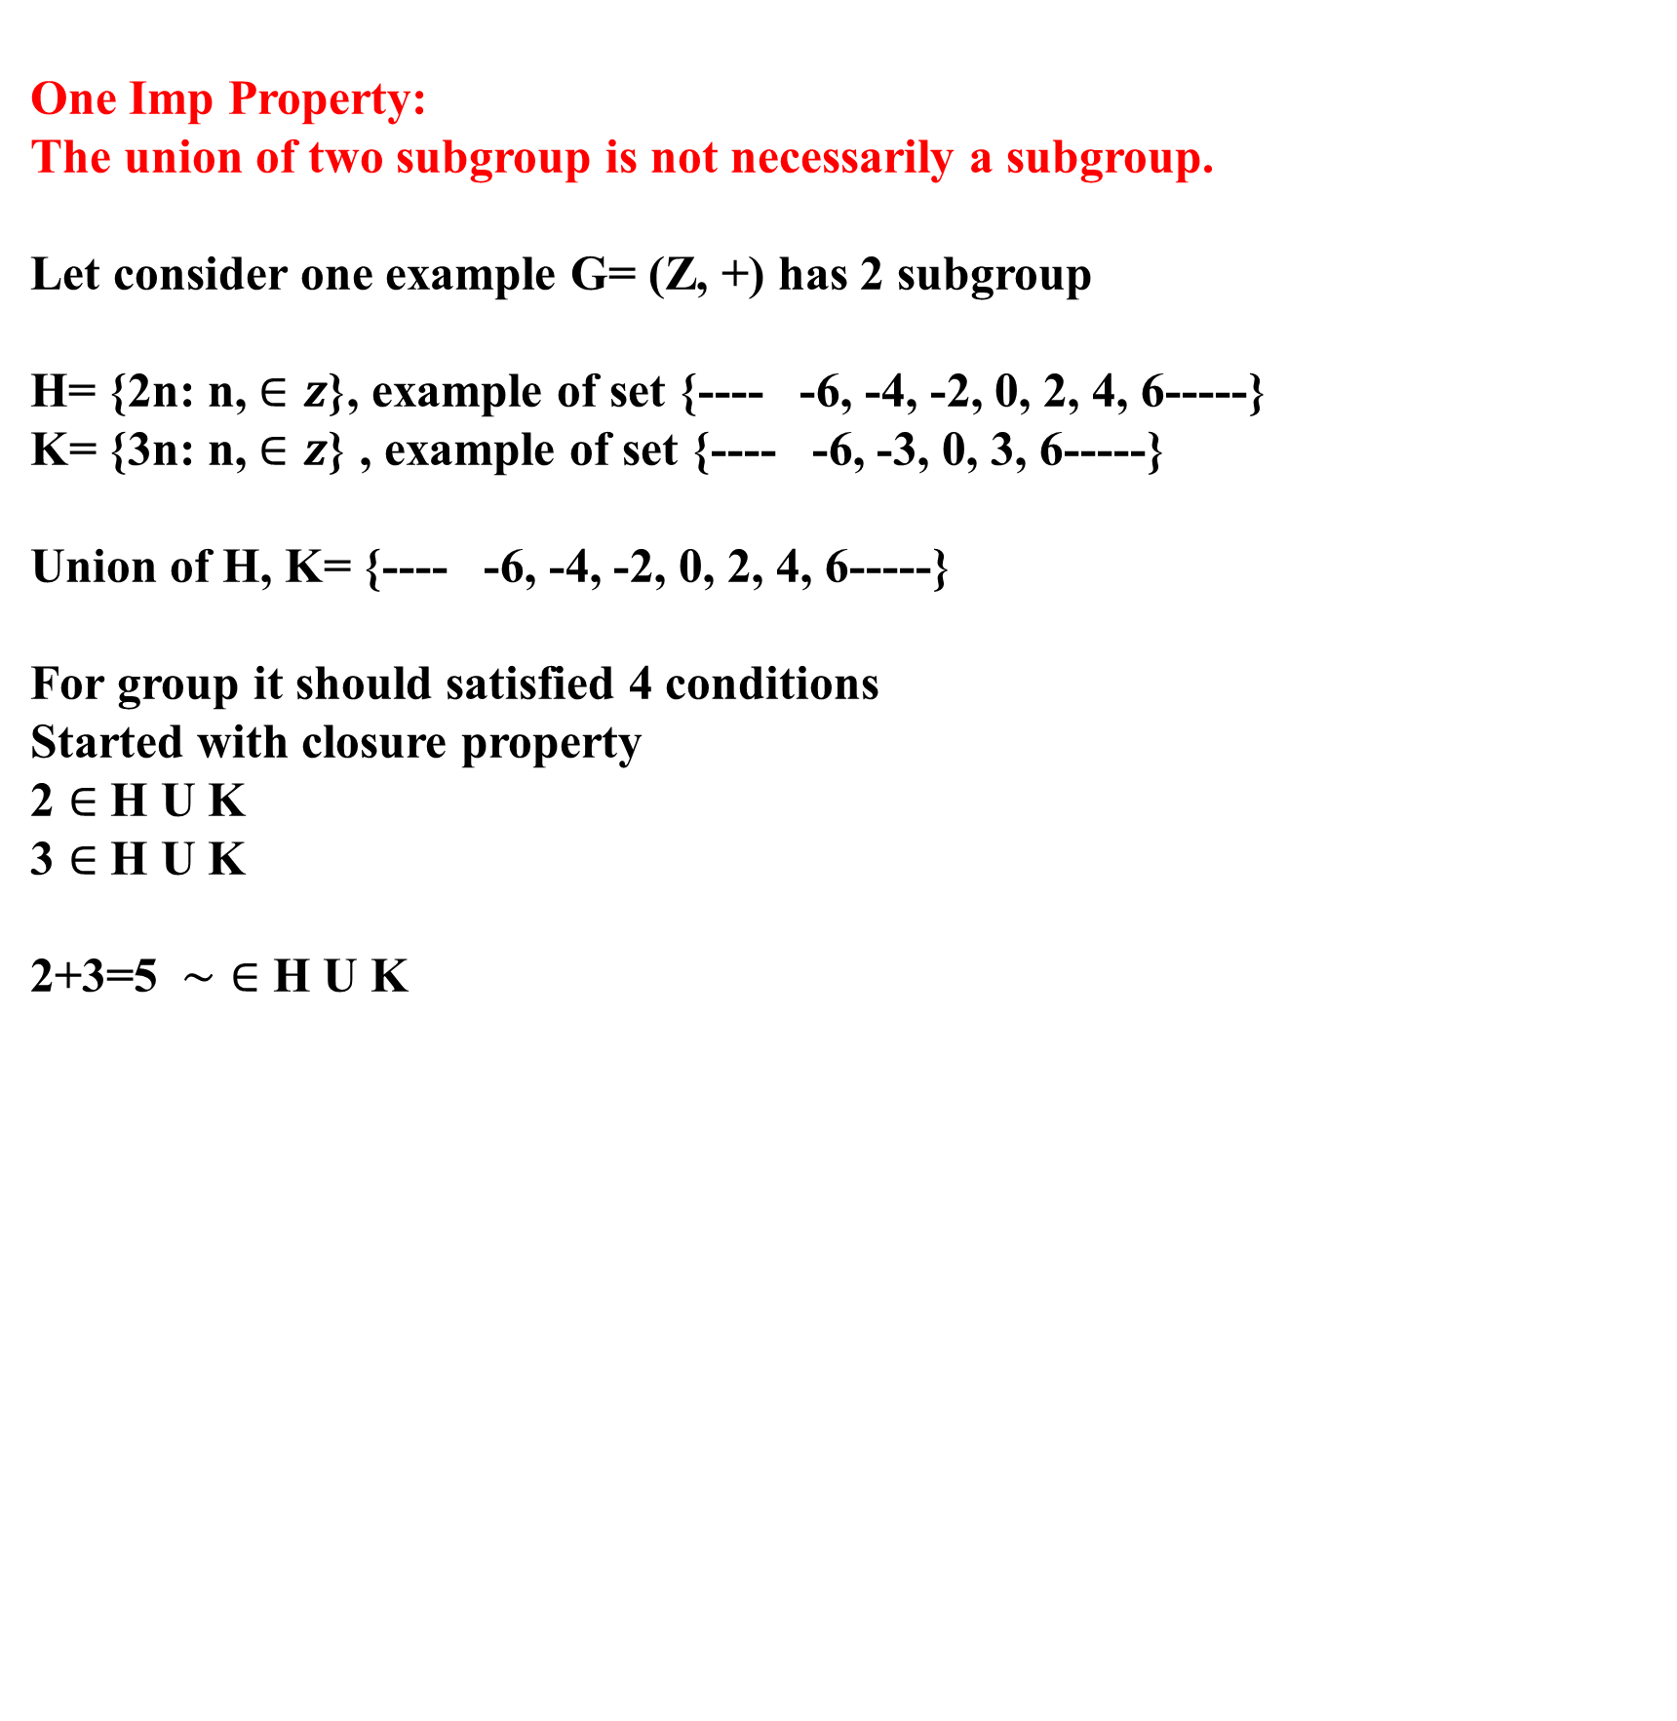
One Imp Property:
The union of two subgroup is not necessarily a subgroup.
Let consider one example G= (Z, +) has 2 subgroup
H= {2n: n, $∈z$}, example of set {---- -6, -4, -2, 0, 2, 4, 6-----}
K= {3n: n, $∈z$} , example of set {---- -6, -3, 0, 3, 6-----}
Union of H, K= {---- -6, -4, -2, 0, 2, 4, 6-----}
For group it should satisfied 4 conditions
Started with closure property
2 $∈$ H U K
3 $∈$ H U K
2+3=5 $\sim ∈$ H U K

Slide 8
Qs. Show that H= {0, 2, 4} is a subgroup of the group that
G= {0, 1, 2, 3, 4, 5} under addition modulo 6.
Ans:

Slide 9
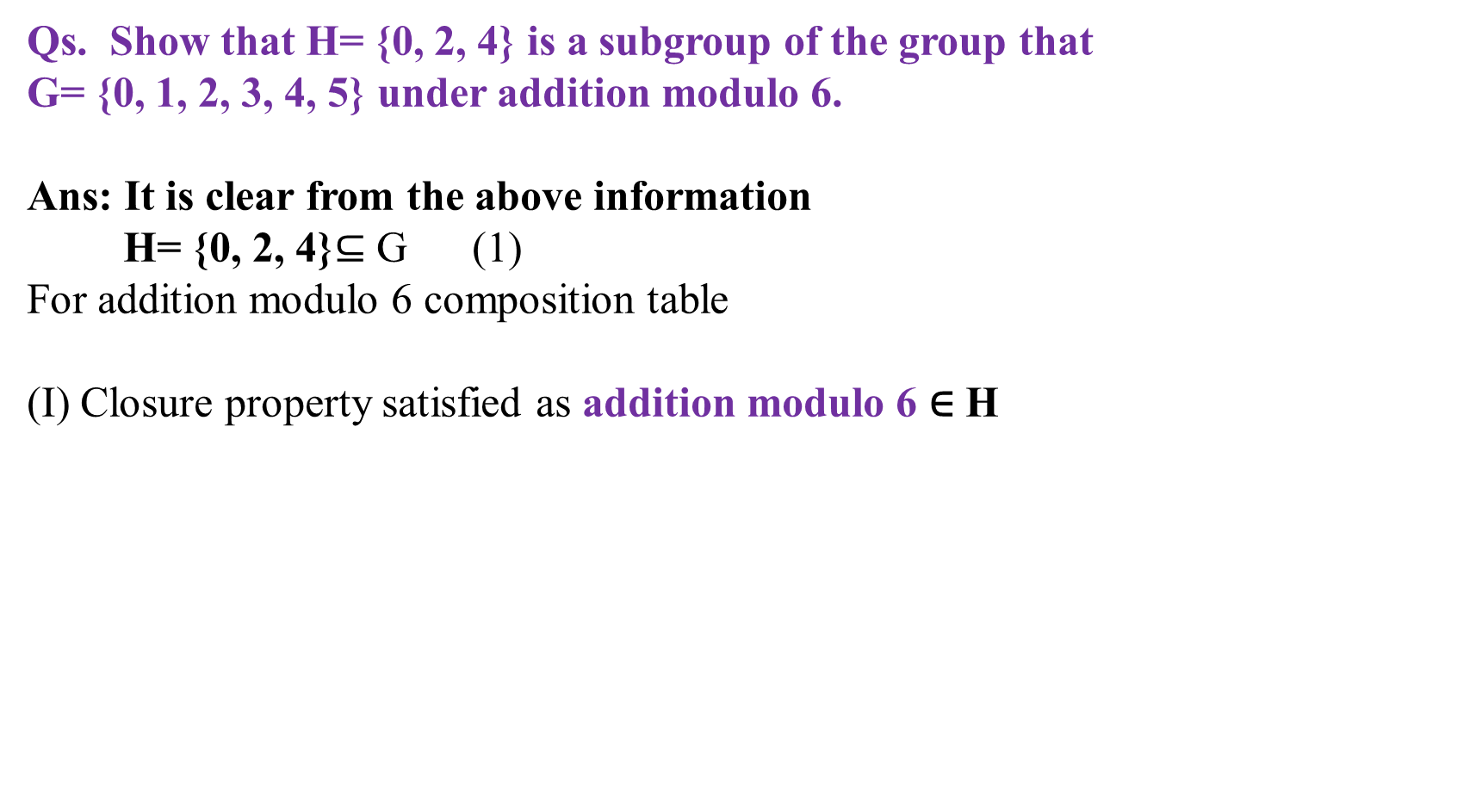
Qs. Show that H= {0, 2, 4} is a subgroup of the group that
G= {0, 1, 2, 3, 4, 5} under addition modulo 6.
Ans: It is clear from the above information
H= {0, 2, 4}$⊆$ G (1)
For addition modulo 6 composition table
(I) Closure property satisfied as addition modulo 6 ∈ H
+6 | 0 | 2 | 4
0 | 0 | 2 | 4
2 | 2 | 4 | 6
4 | 4 | 6 | 8
+6 | 0 | 2 | 4
0 | 0 | 2 | 4
2 | 2 | 4 | 0
4 | 4 | 0 | 2

Slide 10

(II) Associative,
let a, b$, c ε$ G
=> a +6 (b +6 c) = (a +6 b) +6 c $ε$ H
LHS= 0 +6 (2 +6 4)
= 0 +6 (0)
= 0
RHS= (a +6 b) +6 c
= (0 +6 2) +6 4
= (2) +6 4
=>0
(III) Identity
“0” is the identity element can see from table

Slide 11
(IV) Inverse
+6 | 0 | 2 | 4
0 | 0 | 2 | 4
2 | 2 | 4 | 0
4 | 4 | 0 | 2

Slide 12
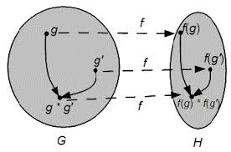
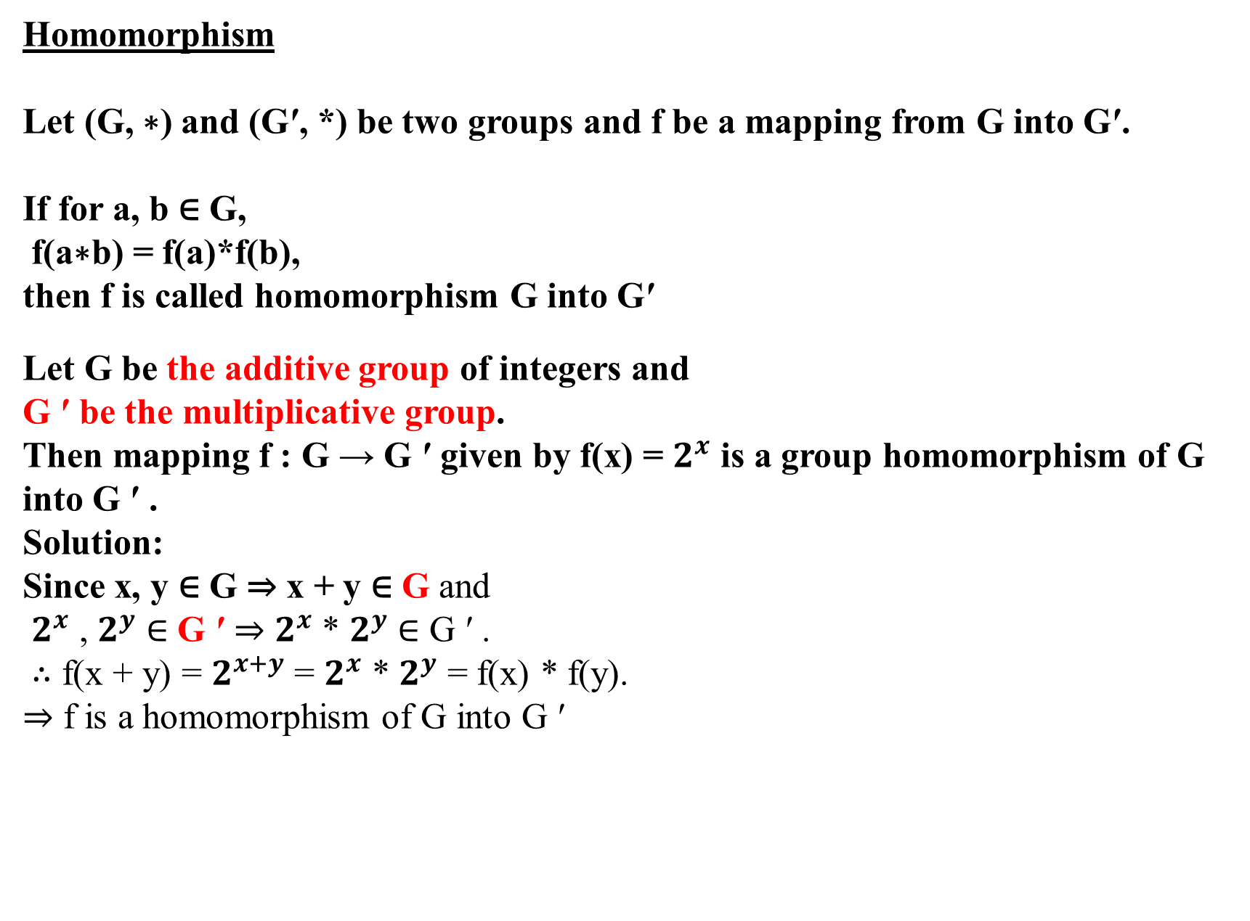
Homomorphism
Let (G, ∗) and (G′, *) be two groups and f be a mapping from G into G′.
If for a, b ∈ G,
f(a∗b) = f(a)*f(b),
then f is called homomorphism G into G′
Let G be the additive group of integers and
G ′ be the multiplicative group.
Then mapping f : G → G ′ given by f(x) = $2^{x}$ is a group homomorphism of G into G ′ .
Solution:
Since x, y ∈ G ⇒ x + y ∈ G and
$2^{x}$ , $2^{y}$ ∈ G ′ ⇒ $2^{x}$ * $2^{y}$ ∈ G ′ .
∴ f(x + y) = $2^{x+y}$ = $2^{x}$ * $2^{y}$ = f(x) * f(y).
⇒ f is a homomorphism of G into G ′

Slide 13
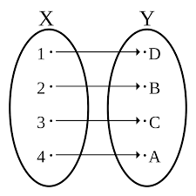
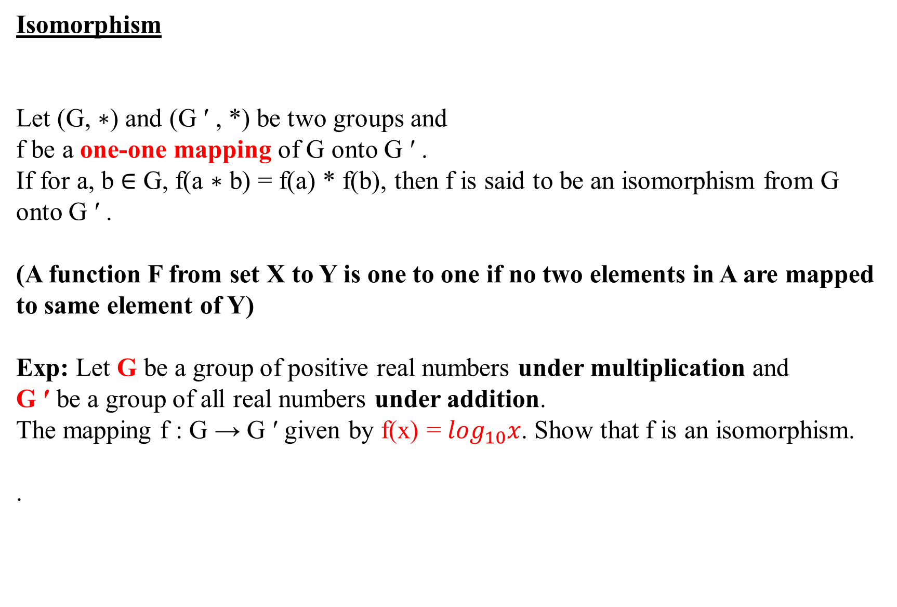
Isomorphism
Let (G, ∗) and (G ′ , *) be two groups and
f be a one-one mapping of G onto G ′ .
If for a, b ∈ G, f(a ∗ b) = f(a) * f(b), then f is said to be an isomorphism from G onto G ′ .
(A function F from set X to Y is one to one if no two elements in A are mapped to same element of Y)
Exp: Let G be a group of positive real numbers under multiplication and
G ′ be a group of all real numbers under addition.
The mapping f : G → G ′ given by f(x) = $\log_{10}x$. Show that f is an isomorphism.
.

Slide 14
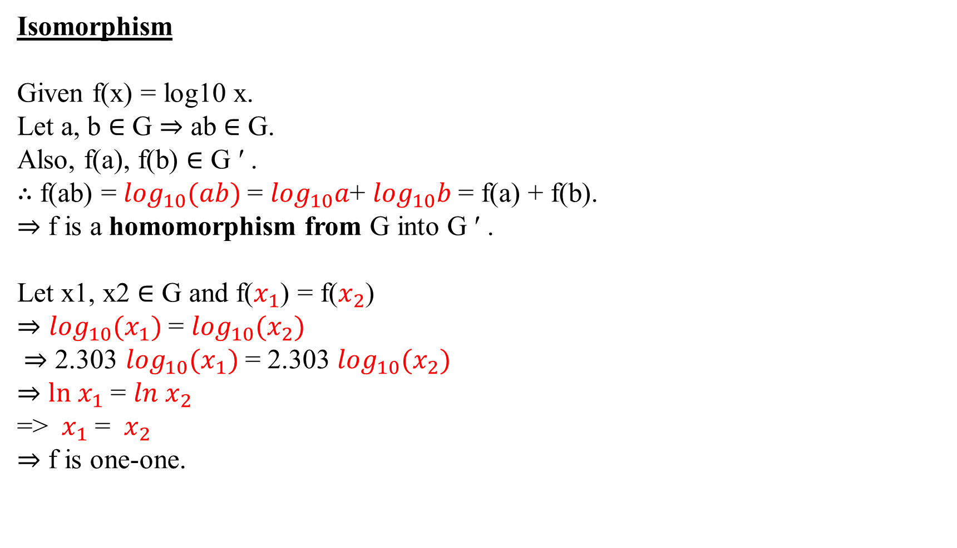
Isomorphism
Given f(x) = log10 x.
Let a, b ∈ G ⇒ ab ∈ G.
Also, f(a), f(b) ∈ G ′ .
∴ f(ab) = $\log_{10}(ab)$= $\log_{10}a$+ $\log_{10}b$ = f(a) + f(b).
⇒ f is a homomorphism from G into G ′ .
Let x1, x2 ∈ G and f($x_{1}$) = f($x_{2}$)
⇒ $\log_{10}(x_{1})$= $\log_{10}(x_{2})$
⇒ 2.303 $\log_{10}(x_{1})$= 2.303 $\log_{10}(x_{2})$
⇒ $ln x_{1}$ = ${ln x}_{2}$
=> $x_{1}$ = ${ x}_{2}$
⇒ f is one-one.

Slide 15
QS.
ONE TO ONE
E
1
2
3
A
B
C
NOT ONE TO ONE

Slide 16
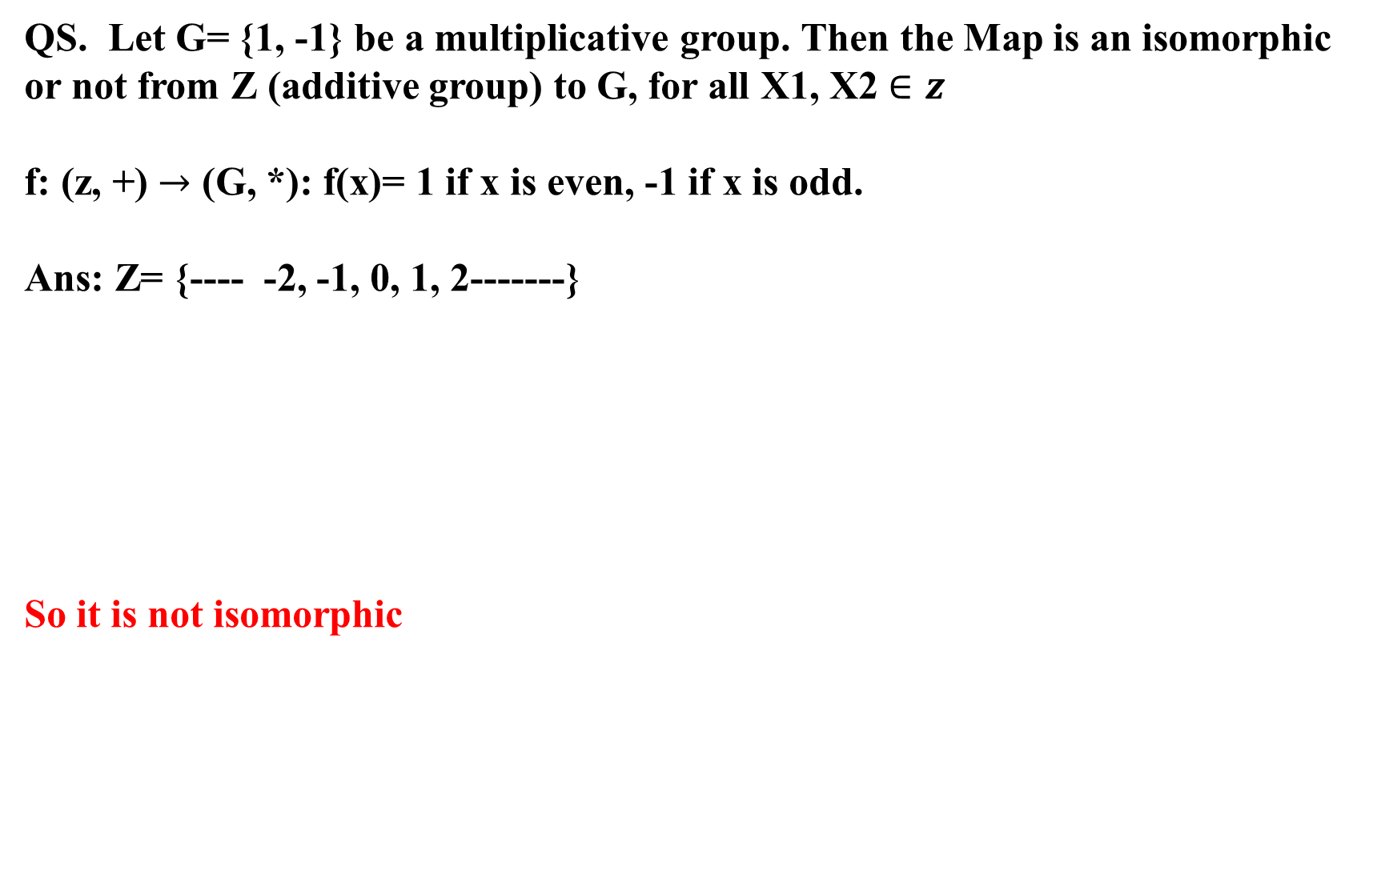
QS. Let G= {1, -1} be a multiplicative group. Then the Map is an isomorphic or not from Z (additive group) to G, for all X1, X2 $∈z$
f: (z, +) $→$ (G, *): f(x)= 1 if x is even, -1 if x is odd.
Ans: Z= {---- -2, -1, 0, 1, 2-------}
So it is not isomorphic
ONE TO ONE
0
-1,1
-2, 2
-3,3
-4,4
E
1
-1
NOT ONE TO ONE
1
2
3
A
B
C
NOT ONE TO ONE

Slide 17
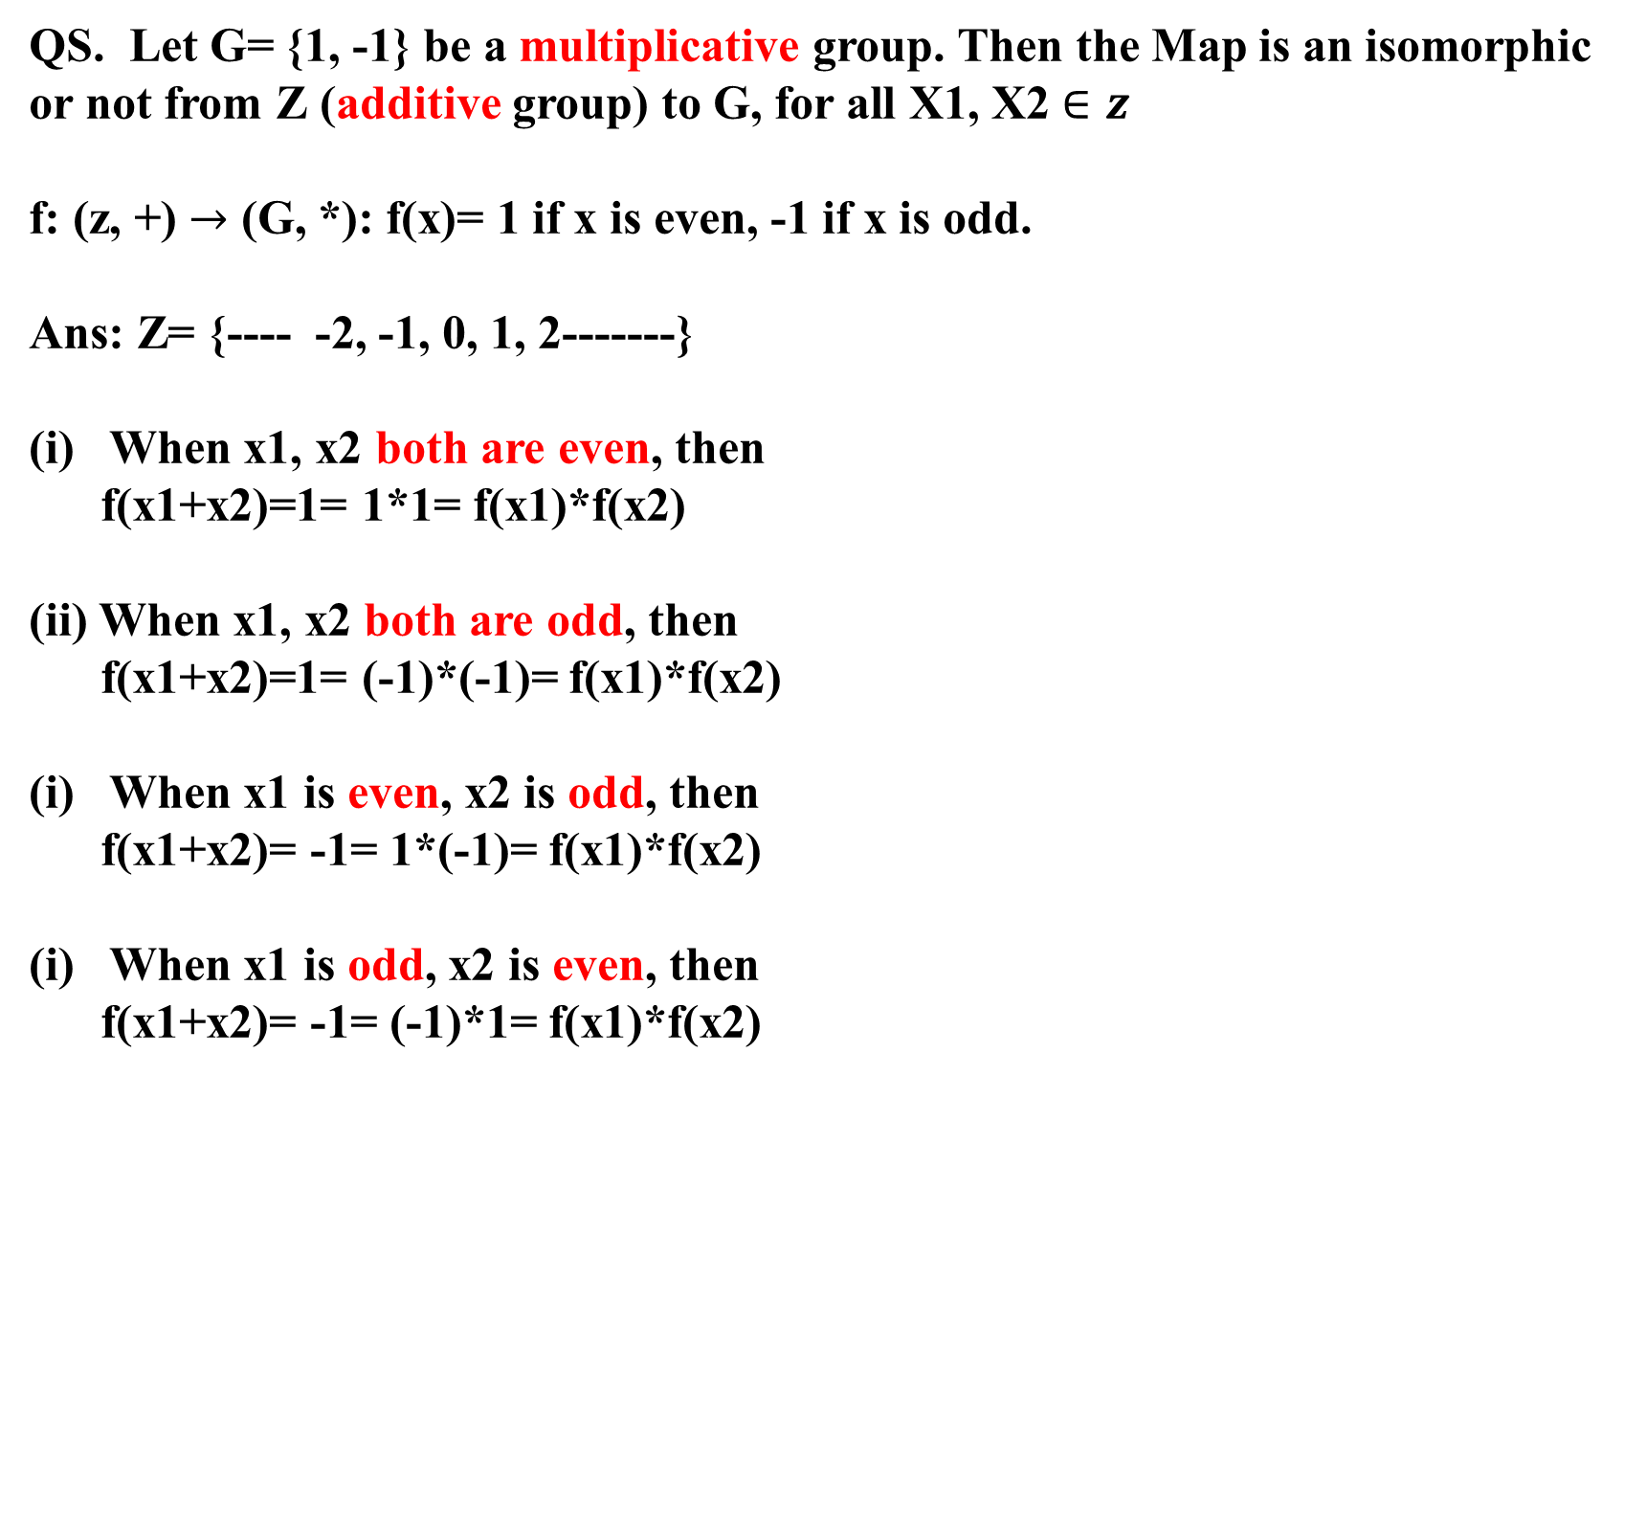
QS. Let G= {1, -1} be a multiplicative group. Then the Map is an isomorphic or not from Z (additive group) to G, for all X1, X2 $∈z$
f: (z, +) $→$ (G, *): f(x)= 1 if x is even, -1 if x is odd.
Ans: Z= {---- -2, -1, 0, 1, 2-------}
When x1, x2 both are even, then
f(x1+x2)=1= 1*1= f(x1)*f(x2)
(ii) When x1, x2 both are odd, then
f(x1+x2)=1= (-1)*(-1)= f(x1)*f(x2)
When x1 is even, x2 is odd, then
f(x1+x2)= -1= 1*(-1)= f(x1)*f(x2)
When x1 is odd, x2 is even, then
f(x1+x2)= -1= (-1)*1= f(x1)*f(x2)

